Slide 1



Department of Artificial Intelligence and Data Science
Enhancing Player Engagement and Retention Through Behavioral Analytics and Feature Optimization in Gaming
Mrs.D Sorna Shanthi
Associate Professor
Giridharan.M
221801504
Madhuvanthiy.S
221801031

Slide 2
Problem Statement and Motivation
A gaming company aims to enhance user engagement by analyzing player behavior and in game interactions. They aim to optimize features and increase player retention.
The motivation behind this mini project is to address the challenges faced by the players using low-end devices . By analysing the player behaviour and in-game interactions, we aim to improve the performance of the game which will ensure smoother and more enjoyable gameplay experience.
Problem Statement:
Motivation:
Third Review
Department of Artificial Intelligence and Data Science
2

Slide 3
Objectives
Increase Player Retention:Increasing the player retention by giving them an exclusive rewards and making the game smoother
Configuration adjustments: Here the game configurations like framerate , graphics settings , smoothness etc.. are being adjusted in order to increase the performance of the player & game.
Tips and tricks: providing in game tips which helps the user to understand and crack the behaviour of game and helps the user’s winning possibilities.
Third Review
Department of Artificial Intelligence and Data Science
3

Slide 4
Abstract
In the rapidly evolving gaming industry, player engagement and retention are critical for the long-term success of any game . By incorporating real-time analytics, the website provides actionable tips to optimize game performance and strategies, while its flexible configuration settings allow players to adjust the game's difficulty, interface, and other parameters according to their skill levels.
Here , we mainly focus on improving player's interaction by enhancing the game performance by adding some configurations , Tips & Tricks to it.
Third Review
Department of Artificial Intelligence and Data Science
4
Notes:
4

Slide 5
Introduction and Overview of the Project
In the world of gaming, maintaining high user engagement and player retention is crucial for the success and longevity of a game . To stay competitive and ensure a satisfying experience for all players, including those using low-end devices, it's essential to continually refine and optimize game features . Our goal is to improve the overall gaming experience through targeted optimizations and adjustments.
The project aims to achieve several key objectives:
Feature Optimization
Tips and Tricks
Configuration Adjustments
Behavioral Analysis
Third Review
Department of Artificial Intelligence and Data Science
5

Slide 6
Literature Survey
S.No | Author Name | Paper Title | Description | Journal | Volume/ Year
1 | Jia, Y., He, Y., Guo, J., & Chen, H. | Understanding Player Behavior in Mobile Games: A Case Study of Honor of Kings | Analyzes in-game data of "Honor of Kings" to predict player retention and identify key engagement factors. Uses machine learning techniques to understand player behavior. | IEEE Transactions on Games | Vol. 13, 2021
2 | Campos, P., Novais, P., & Machado, J. | Behavioral Player Modeling for Dynamic Difficulty Adjustment | Focuses on using player behavior modeling for dynamic difficulty adjustment to enhance engagement by matching game difficulty to player skill levels. | Entertainment Computing | Vol. 38, 2021
Third Review
Department of Artificial Intelligence and Data Science
6

Slide 7
Literature Survey
S.No | Author Name | Paper Title | Description | Journal | Volume/ Year
3 | Jensen, R., & Sifa, R | Predicting Player Engagement in Free-to-Play Games Using Machine Learning | Utilizes machine learning to predict engagement in free-to-play games by analyzing in-game behaviors like session length and frequency. | ACM Transactions on Intelligent Systems and Technology (TIST) | Vol. 12, 2022
4 | Guitart, A., Perianes-Rodriguez, A., & Guimerà, R. | Understanding User Engagement in Mobile Games: A Network Approach | Uses a network-based approach to study user engagement in mobile games, focusing on how social interactions affect retention. | Computers in Human Behavior | Vol. 127, 2022
Third Review
Department of Artificial Intelligence and Data Science
7

Slide 8
Existing System
Graphics Settings: The game has adjustable graphics settings (Low, Medium, High, Ultra), but low-end devices still struggle with performance.
In-Game Tips: The game offers general tips but doesn’t address performance issues for lower-end devices.
Player Data: The game collects data on player behavior but doesn’t focus on optimizing for different devices.
Community Help: Players use forums for advice, but it’s inconsistent and may not solve low-end device problems.
Updates: The game gets regular updates, but fixes for low-end device performance may not be prioritized
Third Review
Department of Artificial Intelligence and Data Science
8

Slide 9
Drawback of Existing System
Limited Optimization for Low-End Devices: Current settings don’t fully address performance issues on low-end devices, leading to lag and poor graphics quality.
Generic In-Game Tips: Existing tips are too broad and don’t offer specific advice for optimizing gameplay on different device types.
Basic Analytics : The current system provides high-level data without detailed insights into how device performance affects gameplay.
Inconsistent Community Support :Community guides and tips vary in quality, making it hard for players to find effective solutions for their device issues.
Lack of Personalization :Features and settings are not tailored to individual device capabilities, leading to a one-size-fits-all approach.
Third Review
Department of Artificial Intelligence and Data Science
9

Slide 10
.
Proposed System
Behavioral Analysis - Track Metrics: Collect basic metrics like playtime and performance offline for personalized insights.
Feature Optimization - Pixel Reduction: Provide adjustable graphics settings to lower resolution and enhance smoothness and Performance Tuning: Include options to tweak in-game settings such as texture quality and shadows.
Tips and Tricks - Image Map: Integrate an interactive image map with pop-up messages that highlight key game details and strategies.
Configuration Adjustments - Custom Settings: Allow users to adjust and save graphics and performance settings to fit their device’s capabilities
Third Review
Department of Artificial Intelligence and Data Science
10

Slide 11
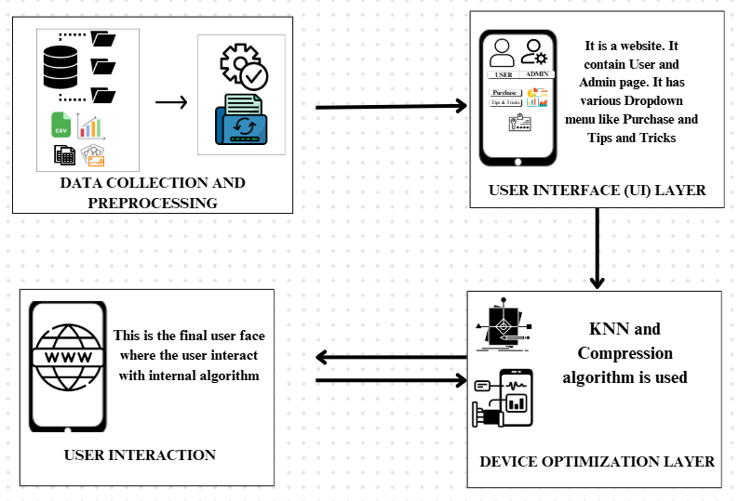
Architecture
Third Review
Department of Artificial Intelligence and Data Science
11
Notes:
11

Slide 12
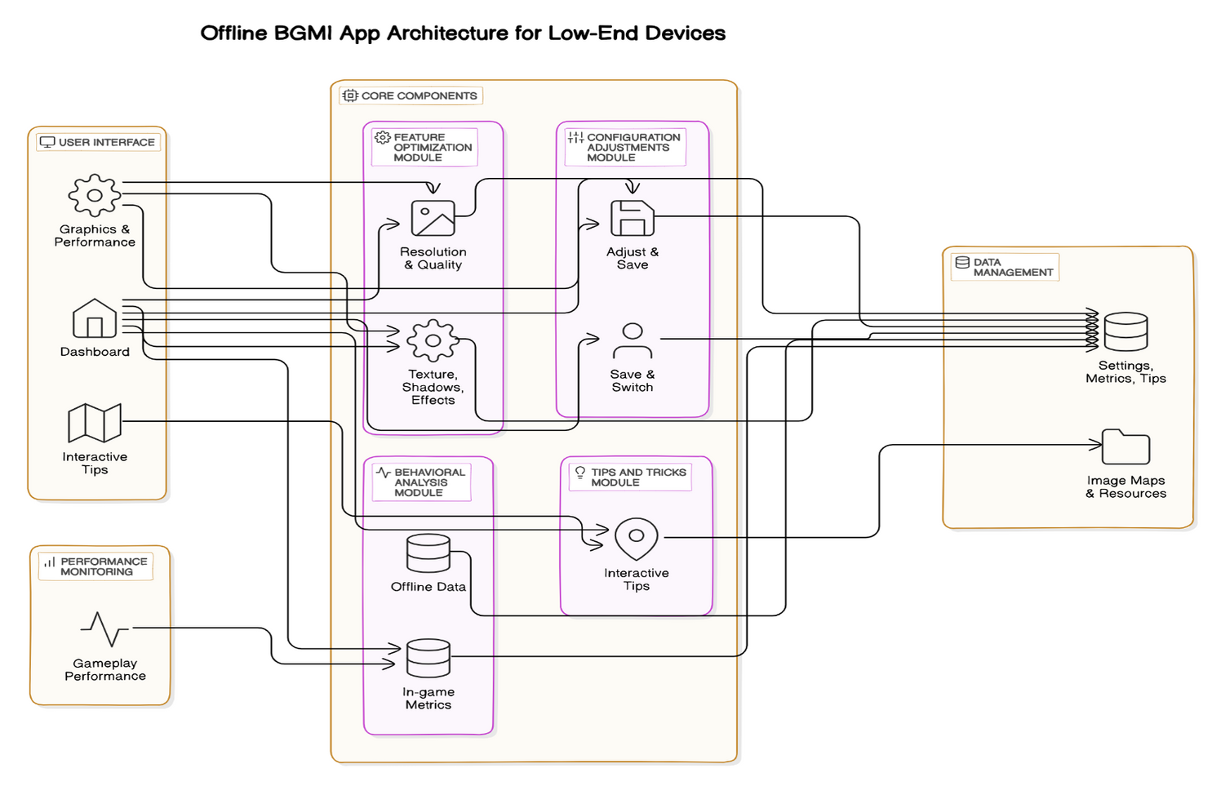
System Architecture
Third Review
Department of Artificial Intelligence and Data Science
12

Slide 13
Lists of Modules
User Interface (UI): Main Dashboard, Settings Screen,
Behavioral Analysis: Data Collection, Analytics Processing
Tips & Tricks: In game tips & tricks
Configuration Management: Settings Adjustment, Profile Management
Performance Monitoring: Metrics Tracking, Optimization Recommendations
Third Review
Department of Artificial Intelligence and Data Science
13

Slide 14
Module 1:User Interface
Importance of UI Module: Enables a smooth and secure experience with login-based personalized access.
User Page: Acts as the central hub for easy navigation and access to game-related content.
Purchase Section: Includes a dropdown menu for popular games like PUBG, PUBG Lite, and EBG.
Performance Booster: Enhances gaming performance, especially for low-end device users.
Tips and Tricks Section: Provides visual strategies and tips to improve user gameplay experience.
Accessibility: Designed for effortless navigation, catering to both casual and competitive gamers.
Goal of UI Design: Focuses on usability and satisfaction, enhancing the overall gaming experience
Third Review
Department of Artificial Intelligence and Data Science
14

Slide 15
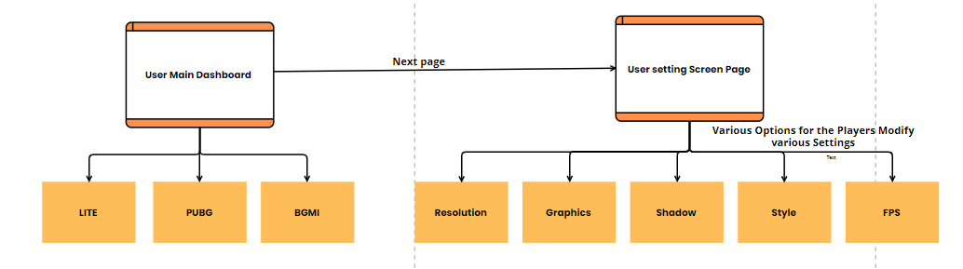
Module 1:User Interface
DATA FLOW DIAGRAM
Third Review
Department of Artificial Intelligence and Data Science
15

Slide 16
Module 2: Behavioral Analysis
Algorithm (Random Forest Regression)
Data Collection: Gather player preferences on settings (resolution, graphics, FPS) and device specs (RAM, CPU, GPU) along with gameplay metrics (FPS, smoothness).
Data Preprocessing: Clean and standardize the data to ensure accuracy and fair comparison across different devices for effective analysis.
Train-Test Split:Divide the dataset into training and testing sets (e.g., 80% for training, 20% for testing) to evaluate the model's performance accurately.
Behavioral Analysis: Identify player interaction patterns, analyze correlations between settings and performance outcomes, and track engagement with app features.
Analytics Processing: Develop a predictive model to recommend optimal settings based on device type and historical user behavior for enhanced performance.
Feedback Loop: Collect user feedback to continuously refine the settings recommendations and enable automatic adjustments based on past behaviors.
Third Review
Department of Artificial Intelligence and Data Science
17

Slide 17
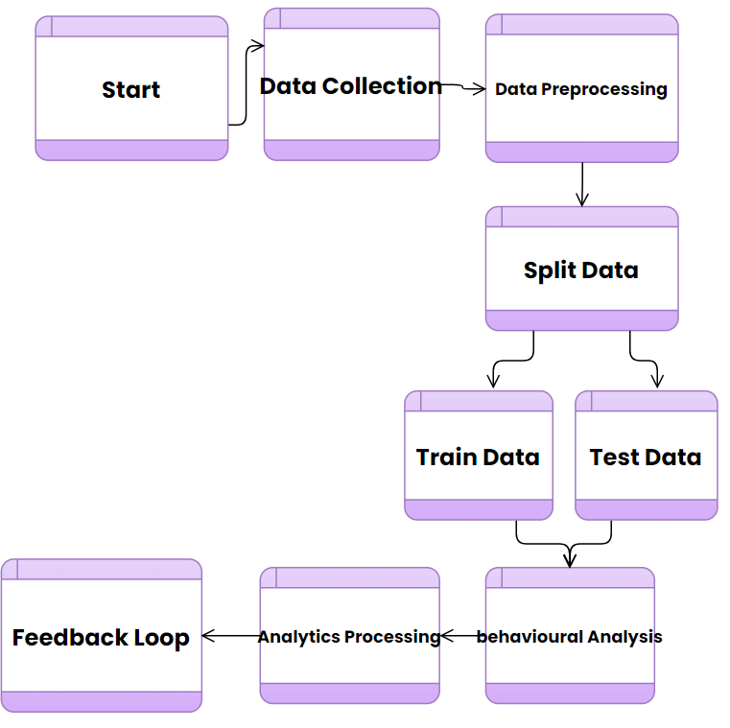
Module 2: Behavioural Analysis
DATA FLOW DIAGRAM
Third Review
Department of Artificial Intelligence and Data Science
18

Slide 18
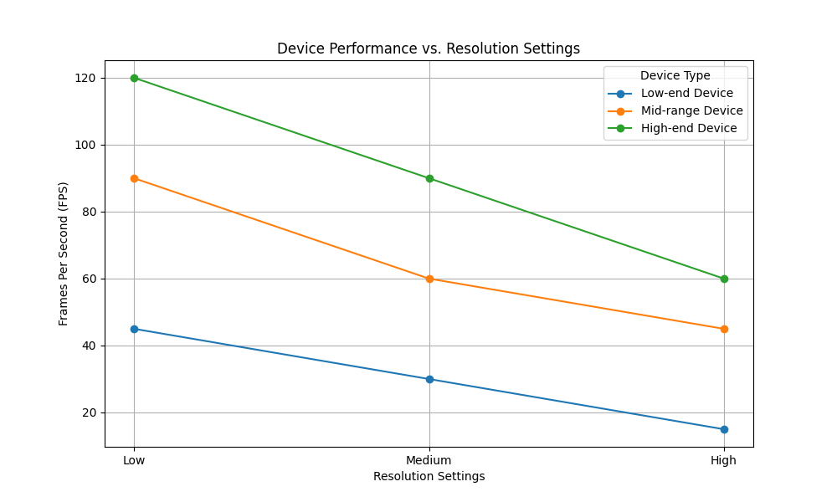
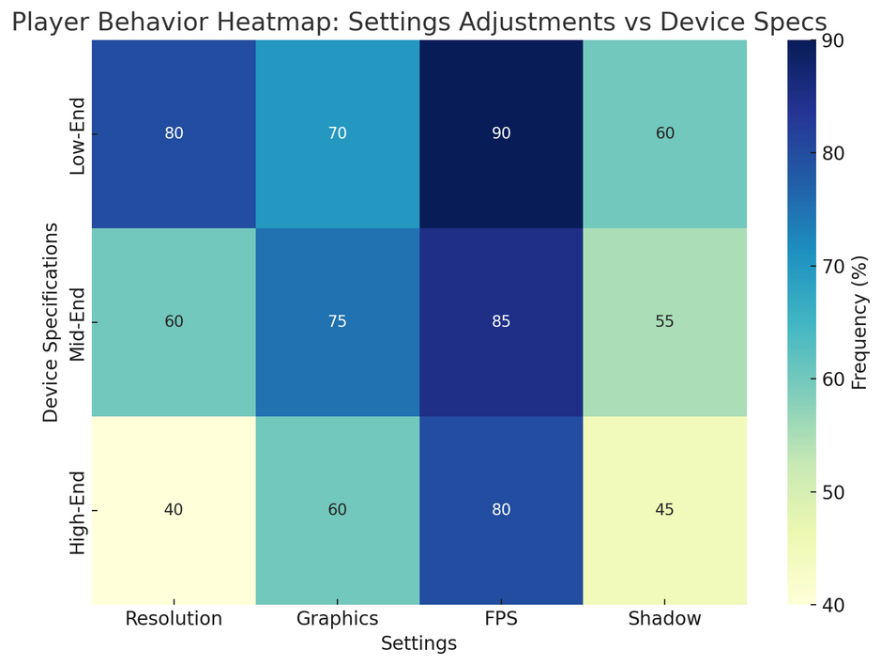
Module 2: Behavioural Analysis
OUTPUT SCREENSHOT
Device Performance vs. Settings Graph
Player Behavior Heatmap
Third Review
Department of Artificial Intelligence and Data Science
19

Slide 19
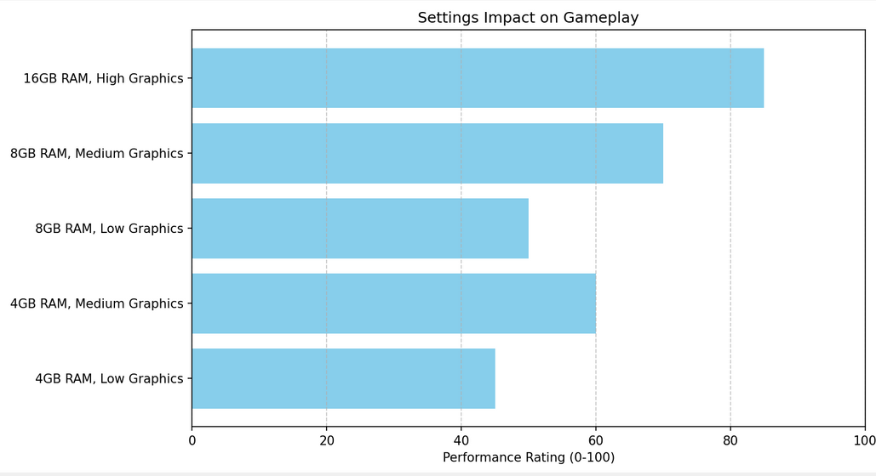
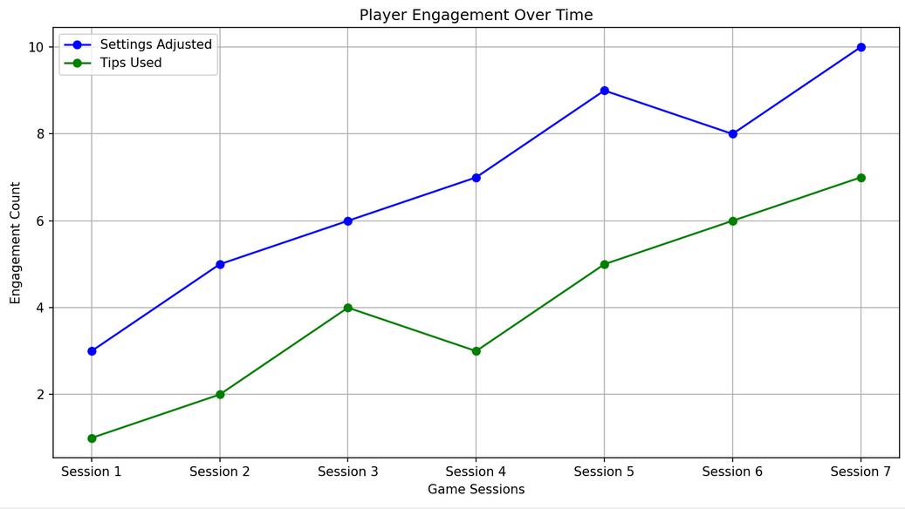
Module 2: Behavioural Analysis
OUTPUT SCREENSHOT
Settings Impact on Gameplay Chart
Engagement Over Time
Third Review
Department of Artificial Intelligence and Data Science
20

Slide 20
Module 3: Tips & Tricks
Algorithm Step: KNN Algorithm
Step 1: Defining the Problem
Predict winning possibilities based on game features.
Step 2: Gathering Data
Collecting datas on:
Drop locations
Average player count
Loot quality (high, medium, low)
Average survival time
Historical win/loss records
Step 3: Prepare the Data
Create a DataFrame with features and target variable (win/loss).
Optionally, compute derived metrics like win rates.
Step 4: Split the Data
Divide the dataset into training (e.g., 80%) and testing sets (e.g., 20%).
21
Third Review
Department of Artificial Intelligence and Data Science

Slide 21
Module 3: Tips & Tricks
Algorithm Step: KNN Algorithm
Step 5: Initialize KNN Model
Choosing the number of neighbours (K) and initialize the KNN classifier.
Step 6: Training the Model
Fit the KNN model using the training dataset.
Step 7: Making Predictions
Using the model to predict outcomes for the test dataset.
Win Rate=Total Games Played /Number of Wins​×100
Average Player Count=n∑i=1n​Player Counti​​ng / N
22
Third Review
Department of Artificial Intelligence and Data Science

Slide 22
Module 3: Tips & Tricks
Algorithm Step: KNN Algorithm
Step 5: Initialize KNN Model
Choosing the number of neighbours (K) and initialize the KNN classifier.
Step 6: Training the Model
Fit the KNN model using the training dataset.
Step 7: Making Predictions
Using the model to predict outcomes for the test dataset.
Win Rate=Total Games Played /
Number of Wins​×100
Average Player Count=n∑i=1n​Player Counti​​ng / N
23
Third Review
Department of Artificial Intelligence and Data Science

Slide 23
Module 3: Tips & Tricks-Code
import matplotlib.pyplot as plt
import numpy as np
# Sample data
locations = ['Farm', 'Gatka', 'Georgopol', 'Kameshki', 'Lipovka', 'Mylta', 'Mylta Power', 'Novorepnoye', 'Pochinki', 'Primorsk', 'Rozhok', 'School', 'Shooting Range', 'Stalber', 'Yasnaya Polyana']
player_count = [27, 24, 30, 22, 25, 23, 28, 26, 25, 24, 23, 22, 20, 21, 28]
loot_quality = {'High': [5, 4, 6, 3, 5, 4, 5, 6, 5, 4, 4, 5, 3, 4, 6], 'Medium': [8, 10, 10, 12, 10, 9, 9, 10, 9, 11, 10, 9, 11, 10, 10], 'Low': [4, 3, 4, 5, 3, 3, 4, 4, 4, 3, 3, 3, 6, 4, 2]}
survival_time = [15, 12, 16, 14, 13, 15, 17, 14, 15, 16, 13, 12, 11, 13, 16]
game_result = {'Win': [18, 17, 20, 16, 18, 17, 19, 20, 18, 17, 16, 17, 15, 16, 20], 'Loss': [9, 7, 10, 6, 7, 6, 9, 6, 7, 7, 7, 5, 5, 5, 8]}
vehicle_spot = [55, 60, 58, 62, 57, 59, 63, 61, 60, 58, 59, 57, 56, 55, 62]
fig, axs = plt.subplots(2, 3, figsize=(20, 15))
fig.suptitle('Bar Charts for Each Column Grouped by Drop Location', fontsize=16)
Third Review
Department of Artificial Intelligence and Data Science
24

Slide 24
Module 3: Tips & Tricks-Code
x = np.arange(len(locations))
width = 0.25
# Subplots
plots = [
(axs[0, 0], player_count, 'Average Player Count', 'Average Player Count'),
(axs[1, 0], survival_time, 'Average Survival Time', 'Average Survival Time'),
(axs[1, 2], vehicle_spot, 'Average Vehicle Spot Percentage', 'Average Vehicle Spot Percentage')
]
for ax, data, title, ylabel in plots:
ax.bar(locations, data, color='skyblue')
ax.set_title(title)
ax.set_ylabel(ylabel)
ax.tick_params(axis='x', rotation=45)
Third Review
Department of Artificial Intelligence and Data Science
25

Slide 25
Module 3: Tips & Tricks-Code
for i, (key, color) in enumerate(zip(loot_quality.keys(), ['green', 'orange', 'blue'])):
axs[0, 1].bar(x + (i - 1) * width, loot_quality[key], width, label=key, color=color)
axs[0, 1].set_title('Loot Quality by Drop Location')
axs[0, 1].set_ylabel('Loot Quality')
axs[0, 1].set_xticks(x)
axs[0, 1].set_xticklabels(locations, rotation=45)
axs[0, 1].legend()
# Game Result
for i, (key, color) in enumerate(zip(game_result.keys(), ['orange', 'blue'])):
axs[1, 1].bar(x + (i - 0.5) * width, game_result[key], width, label=key, color=color)
axs[1, 1].set_title('Game Result by Drop Location')
axs[1, 1].set_ylabel('Game Result')
axs[1, 1].set_xticks(x)
axs[1, 1].set_xticklabels(locations, rotation=45)
axs[1, 1].legend()
axs[0, 2].axis('off') # Hide empty subplot
plt.tight_layout(rect=[0, 0.03, 1, 0.95])
plt.show()
Third Review
Department of Artificial Intelligence and Data Science
26

Slide 26
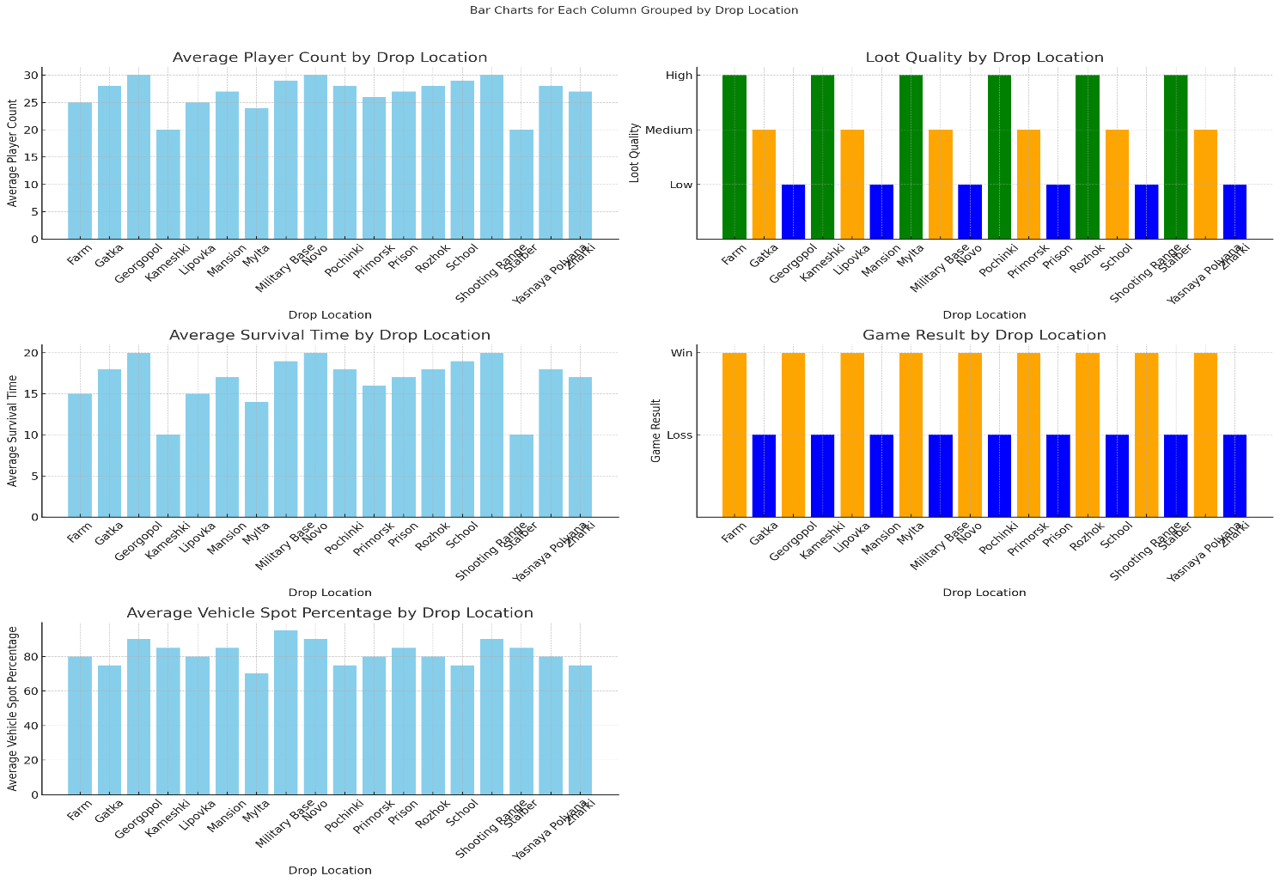
Module 3: Tips & Tricks-Code Output
Third Review
Department of Artificial Intelligence and Data Science
27

Slide 27
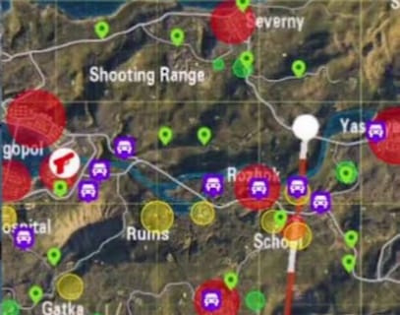
Module 3: Tips & Tricks
28
Third Review
Department of Artificial Intelligence and Data Science

Slide 28
Module 4: Configuration
Key Steps to Reduce Graphics: Compression Algorithm
Locate the INI File:
Find the configuration file typically named config.ini located in the game installation directory or the user-specific app data folder.
Adjust Graphics Settings:
Open the config.ini file using a text editor.
Modify key parameters to reduce graphics quality:
Resolution: Lower the screen resolution by changing width and height settings (e.g., Width=1280 and Height=720).
Texture Quality: Set texture quality to low (e.g., TextureQuality=Low).
Shadows: Disable or reduce shadow effects (e.g., ShadowQuality=Off or ShadowQuality=Low).
Anti-Aliasing: Turn off anti-aliasing (e.g., AntiAliasing=Off).
Effects Quality: Set effects to low (e.g., EffectsQuality=Low).
Save Changes:
After making the adjustments, save the config.ini file and close the text editor.
Launch Game:
Start the game to see the improvements in performance. The reduced graphics settings should lead to smoother gameplay and reduced lag.
Third Review
29
Department of Artificial Intelligence and Data Science

Slide 29
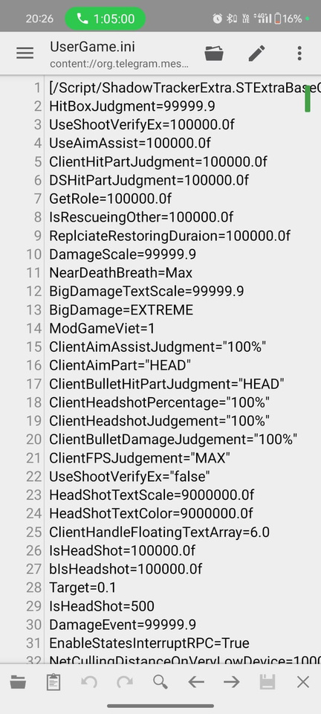
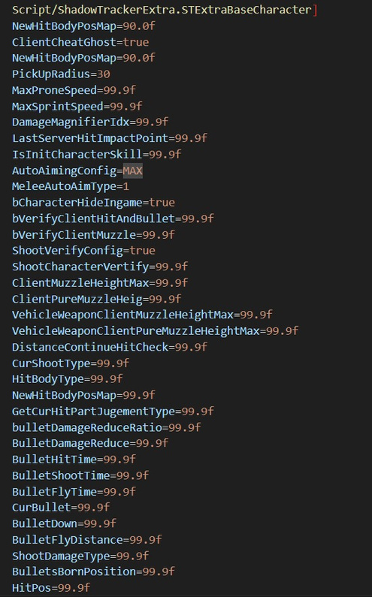
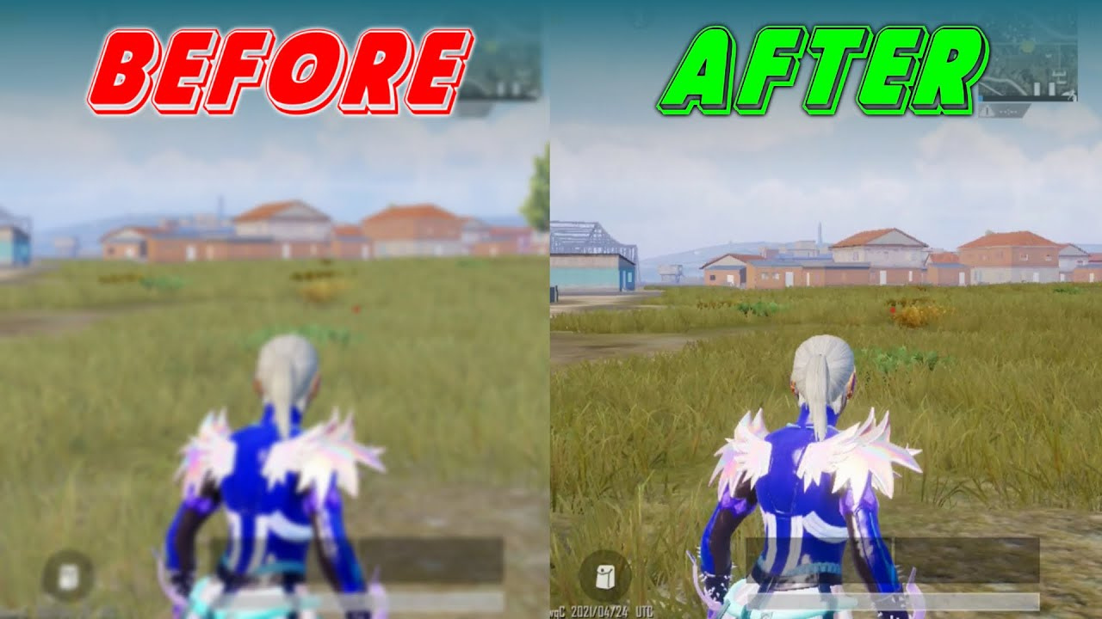
Module 4: Configuration
Before Config
After Config
Department of Artificial Intelligence and Data Science
30
Third Review

Slide 30
Module 5: Performance Monitoring
Algorithm
Data Collection: Gather user-modified settings (resolution, graphics, FPS) and real-time metrics (FPS, CPU/GPU usage, temperature, lag) along with device specifications (RAM, CPU, GPU).
Data Preprocessing: Clean and normalize the collected data to remove inconsistencies and ensure accurate performance comparisons across devices.
Performance Metrics Tracking: Monitor and log in-game performance metrics in real-time to identify lags or frame drops after adjustments and track the effects of setting changes.
Optimization Recommendations: Build a predictive model using Random Forest Regression to analyze historical data and recommend optimal settings for each user’s device.
Recommendation Feedback: Collect user feedback on the suggested settings to refine the predictive model continuously and improve performance recommendations based on real-world experiences.
Third Review
Department of Artificial Intelligence and Data Science
31

Slide 31
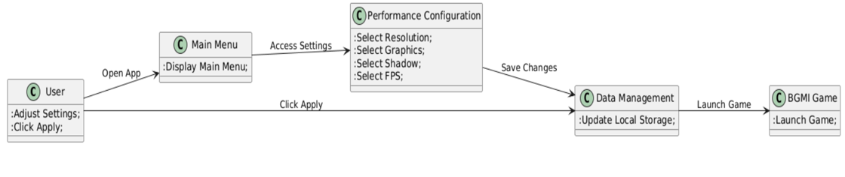
Module 5: Performance Monitoring
DATA FLOW DIAGRAM
Third Review
Department of Artificial Intelligence and Data Science
32

Slide 32
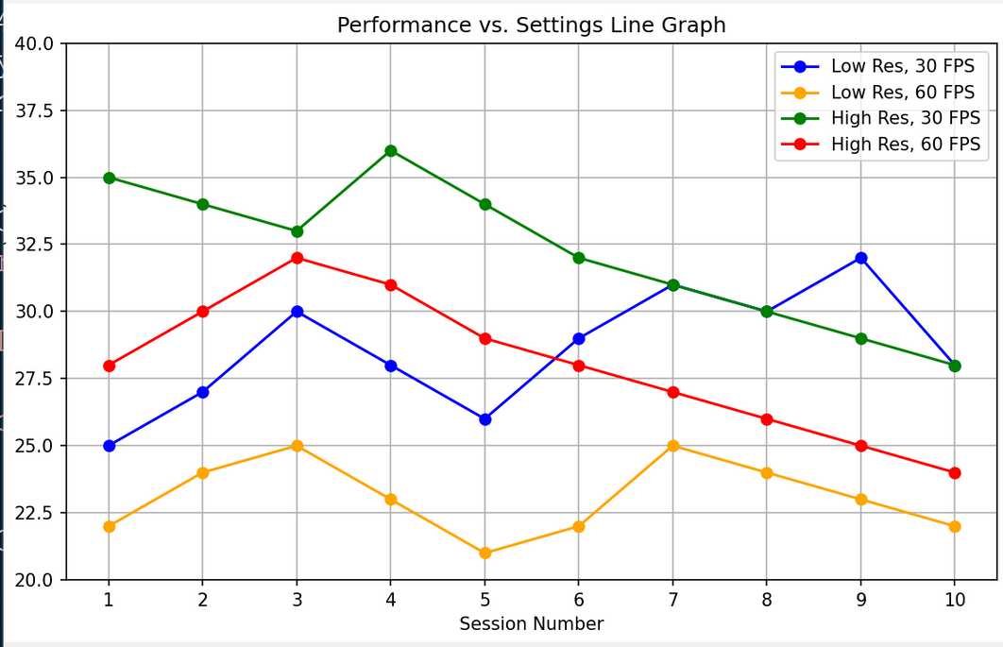
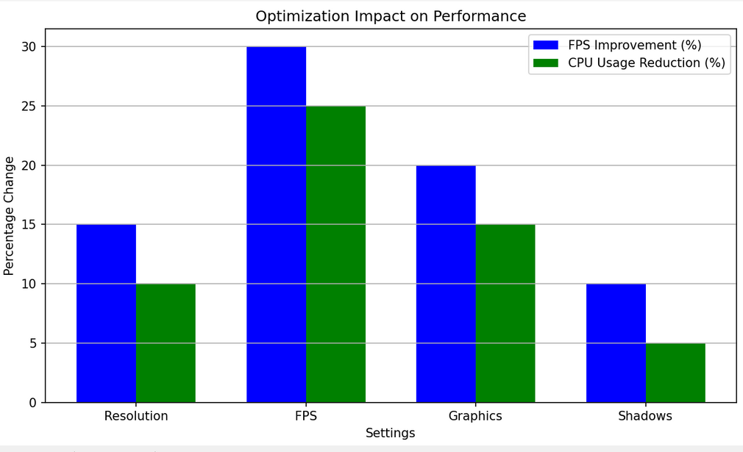
Module 5: Performance Monitoring
Output Screenshot
Performance vs. Settings Line Graph
Optimization Impact Bar Chart
Third Review
Department of Artificial Intelligence and Data Science
33

Slide 33
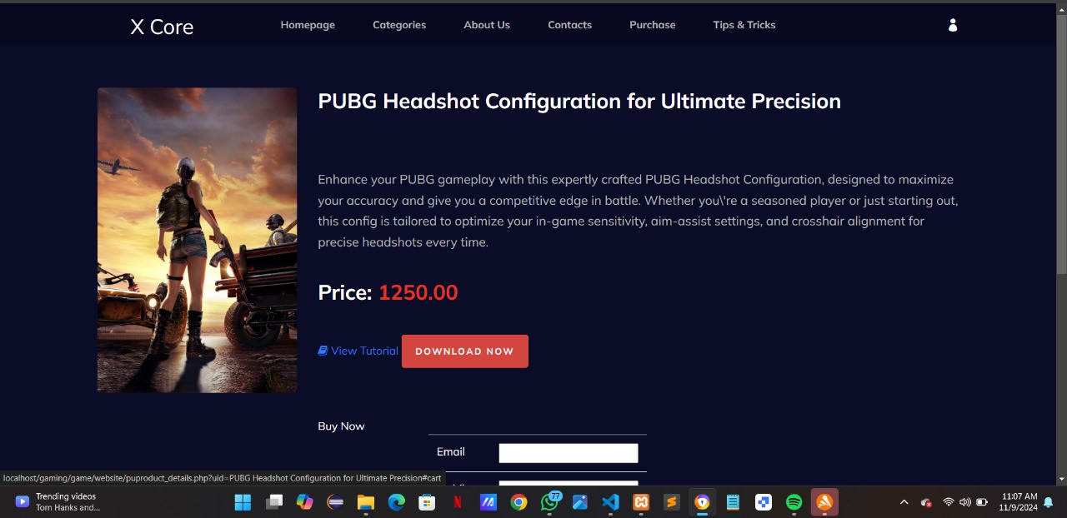
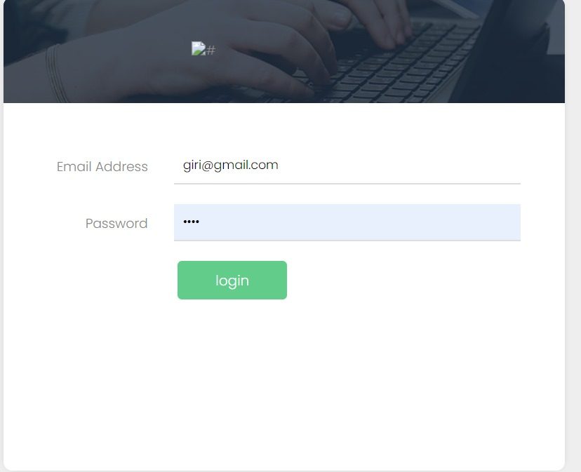
Output Screenshots
Third Review
Department of Artificial Intelligence and Data Science
34

Slide 34
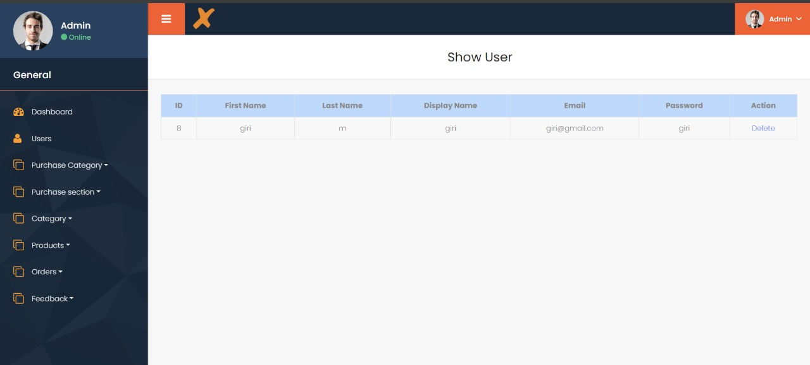
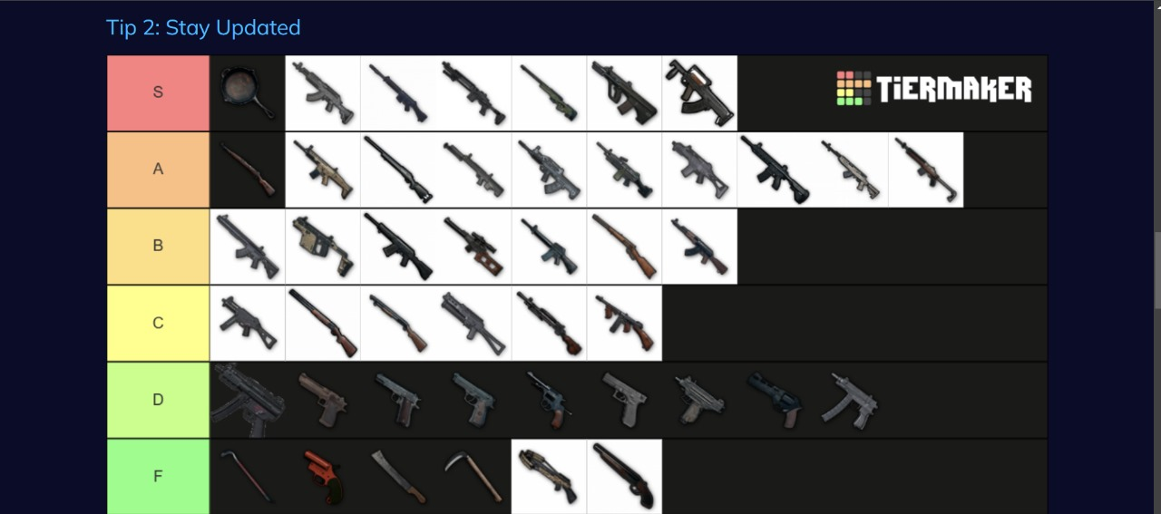
Output Screenshots
Third Review
Department of Artificial Intelligence and Data Science
34

Slide 35
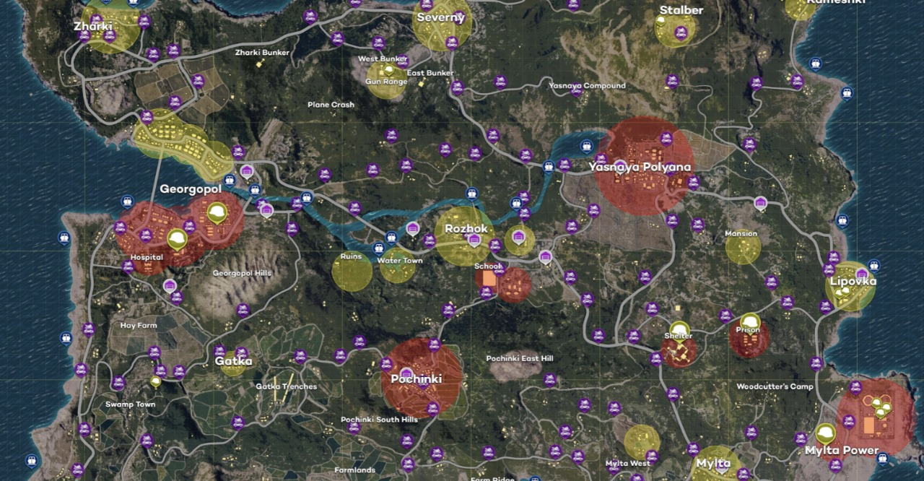
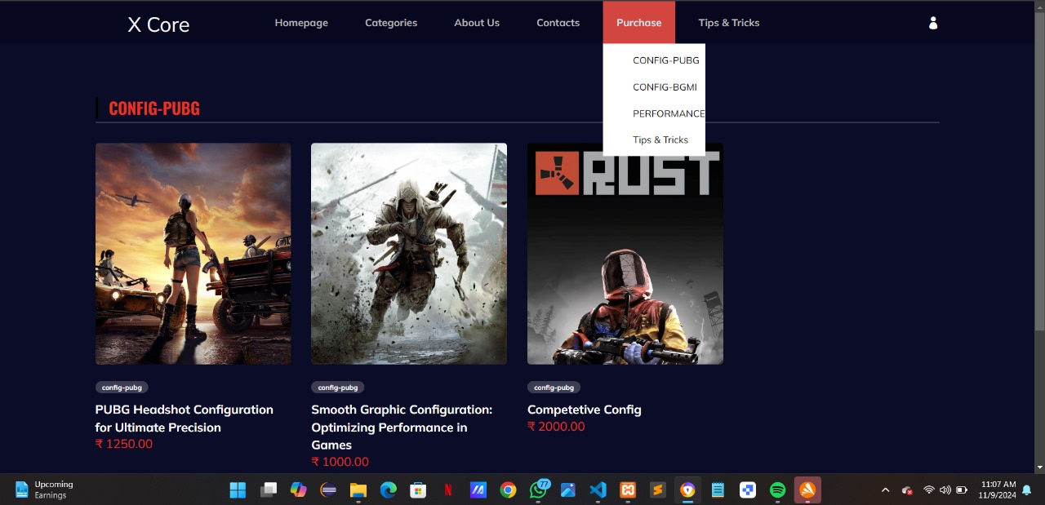
Output Screenshots
Third Review
Department of Artificial Intelligence and Data Science
34

Slide 36
References
1."Analyzing and Predicting Player Churn in Online Games Using Player Behavior“ by D. T. Nguyen, P. Zhou, P. Q. Dinh, D. M. Chiu, and J. C. S. Lui.
2."Behavioral Data Mining for Personalized User Modeling in Multiplayer Online Games" by M. Sifa, D. Drachen, and C. Bauckhage.
3."Player Churn Prediction in Online Games with the Cauchy Process“ by D. Hadiji, A. Sifa, D. Drachen, A. Thurau, C. Bauckhage, and K. Kersting:
4."Clustering of Player Trajectories for Next-Goal Prediction"by R. Lopes, R. Bidarra, and R. Bidarra.
5."Improving User Retention in Multiplayer Online Games via Prediction of Player Dropouts" by M. Runge, J. Zuo, A. Drachen, and M. Sifa.
Third Review
Department of Artificial Intelligence and Data Science
34

Slide 37
Thank You
Third Review
Department of Artificial Intelligence and Data Science
35

